Slide 1
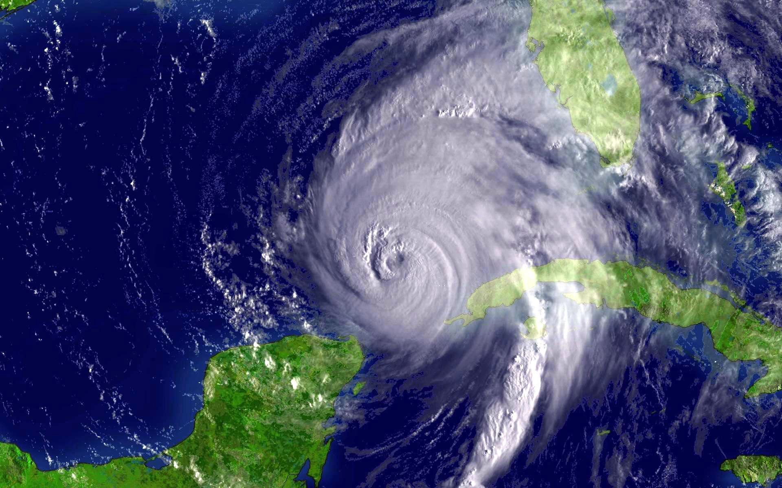

Ready for Stormy Weather? Isaac Ginis Graduate School of Oceanography University of Rhode Island
HWRF Ocean: The Princeton Ocean Model
Isaac Ginis
Graduate School of Oceanography
University of Rhode Island
HWRF Tutorial
NCWCP, College Park, MD
25-27 January 2016

Slide 2
Why Couple a Fully 3-D Ocean Model to a Hurricane Model?
To create accurate SST during hurricane model integration
Evaporation (moisture flux) from sea surface provides heat energy to drive a hurricane
Available energy decreases if storm-core SST decreases
Uncoupled hurricane models with static SST neglect SST cooling during integration → high intensity bias
One-dimensional (vertical-only) ocean models neglect upwelling and horizontal advection, both of which can impact SST during integration

Slide 3
Early history of Princeton Ocean Model
Three-dimensional, primitive equation, numerical ocean model (commonly known as POM)
Originally developed by Alan Blumberg and George Mellor in the late 1970’s
Uses Mellor-Yamada Level 2.5 turbulence closure model
Initially used for coastal ocean circulation applications
Open to the community during the 1990’s and 2000’s
Many user-generated changes incorporated into “official” code version housed at Princeton University

Slide 4
Developing POM for Tropical Cyclones
Available POM code version transferred to University of Rhode Island (URI) in 1994
POM code changes made at URI specifically to address ocean response to hurricane wind forcing
This POM version coupled to GFDL hurricane model at URI
Coupled GFDL/POM model operational at NCEP in 2001
Additional POM upgrades made at URI during 2000’s (e.g. initialization) and implemented in operational GFDL/POM
Same version of POM coupled to operational HWRF in 2007
New version created in 2014: Message Passing Interface POM for tropical cyclones (MPIPOM-TC)

Slide 5
Developing a new MPIPOM-TC
POM community code development
2004
pom2k
2012
sbPOM
1977
pmod
1994
pom
2004 POM
Users Guide
2013 HWRF
Users Guide
URI’s new
MPIPOM-TC
1994 pom
at URI
2013
POM-TC
URI-based code development

Slide 6
New Features in MPIPOM-TC
MPIPOM-TC uses MPI software to run efficiently on multiple processors, allowing for both higher grid resolution and a larger ocean domain than POM-TC
MPIPOM-TC accepts flexible initialization options
MPIPOM-TC is an adaptation of sbPOM, which has community support and includes 18 years of physics updates and bug fixes
MPIPOM-TC is a modernized code with NetCDF I/O
MPIPOM-TC uses a single prognostic code in all worldwide HWRF ocean basins

Slide 7
POM-TC Atlantic Domains: “United” and “East Atlantic”
47.5°N
~18-km grid
spacing
225
98.5°W
254
50°W
10.0°N
60°W
157
30°W

Slide 8
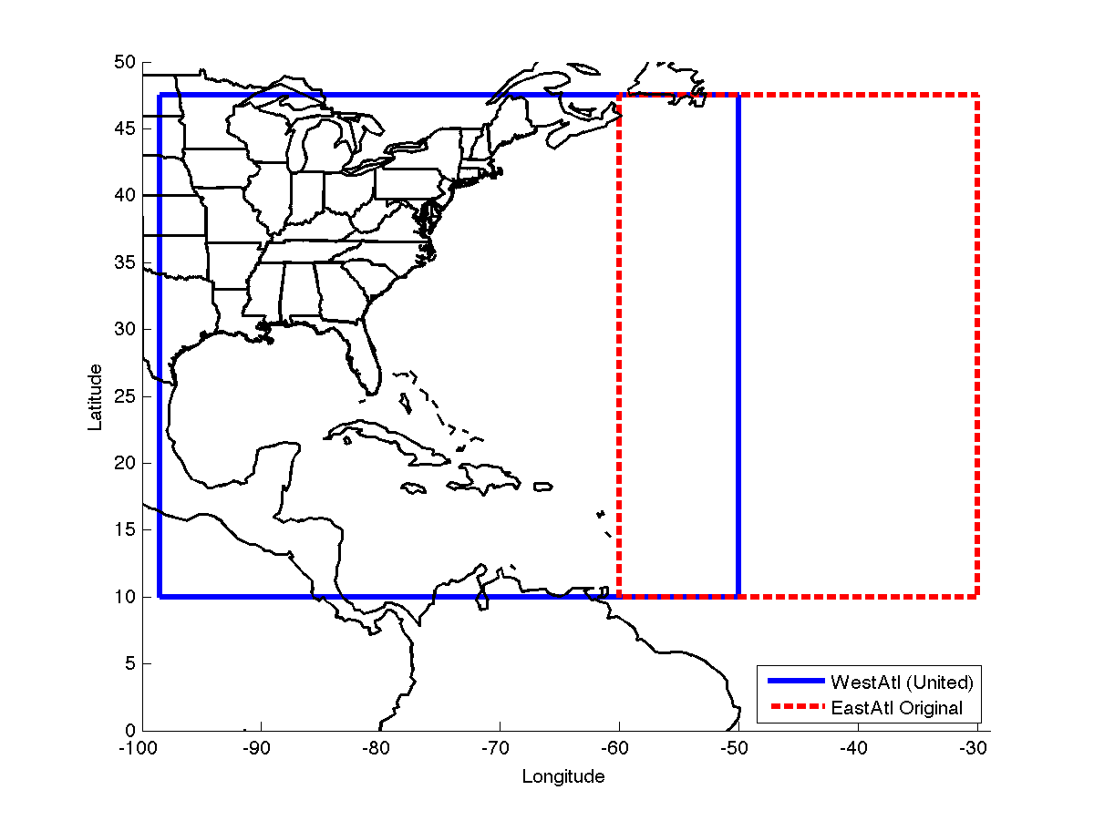
MPIPOM-TC Transatlantic domain
47.5°N
~9 km
horizontal
grid spacing
449
10.0°N
869
15.3°W
98.5°W

Slide 9
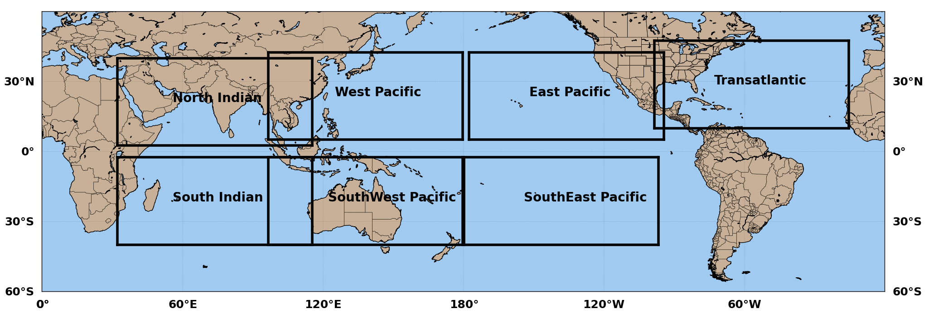
MPIPOM domains worldwide

Slide 10
POM Numerical Design

Slide 11
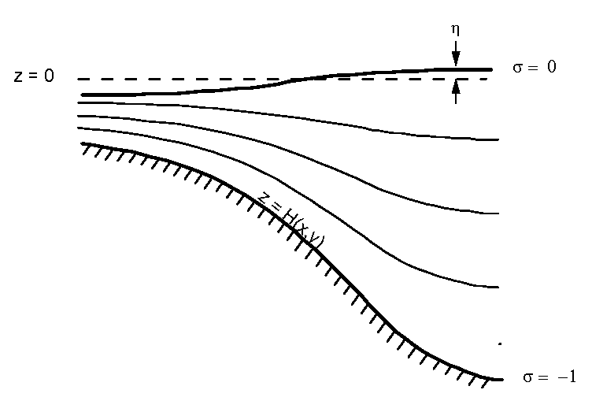
Sigma Vertical Coordinate
23 vertical sigma levels; free surface (η)
Level placement scaled based on ocean bathymetry
Largest vertical spacing occurs where ocean depth is 5500 m
Location of 23 half-sigma levels when ocean depth is 5500 m:
5, 15, 25, 35, 45, 55, 65, 77.5, 92.5, 110, 135, 175, 250, 375,
550, 775, 1100, 1550, 2100, 2800, 3700, 4850, and 5500 m

Slide 12
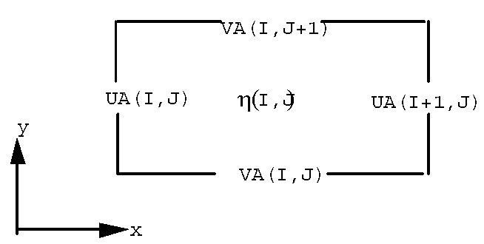
Arakawa-C Grid: External Mode
Plan View
Horizontal spatial differencing occurs on staggered Arakawa-C grid
2-D variables “UA” and “VA” are calculated at shifted location from “η”

Slide 13
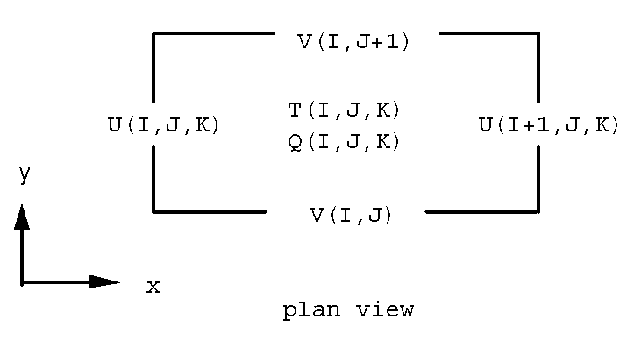
Arakawa-C Grid: Internal Mode
Plan View
Horizontal spatial differencing occurs on staggered Arakawa-C grid
3-D variables “U” and “V” are calculated at shifted location from “T” and “Q”
“T” here represents variables “T”, “S”, and “RHO”
“Q” here represents variables “Km”, “Kh”, “Q2”, and “Q2l”

Slide 14
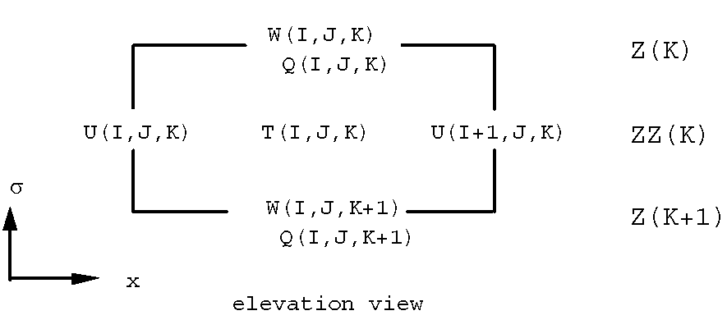
Vertical Grid: Internal Mode
Elevation View
Vertical spatial differencing also occurs on staggered grid
3-D variables “W” and “Q” are calculated at shifted depth from “T” and “U”
“T” here represents variables “T”, “S”, and “RHO”
“Q” here represents variables “Km”, “Kh”, “Q2”, and “Q2l”

Slide 15
Time Stepping
POM has a split time step
External (two-dimensional) mode uses short time step:
22.5 seconds during pre-coupled initialization
13.5 seconds during coupled integration
Internal (three-dimensional) mode uses long time step:
15 minutes during pre-coupled initialization
9 minutes during coupled integration
Horizontal time differencing is explicit
Vertical time differencing is implicit

Slide 16
POM Physics

Slide 17
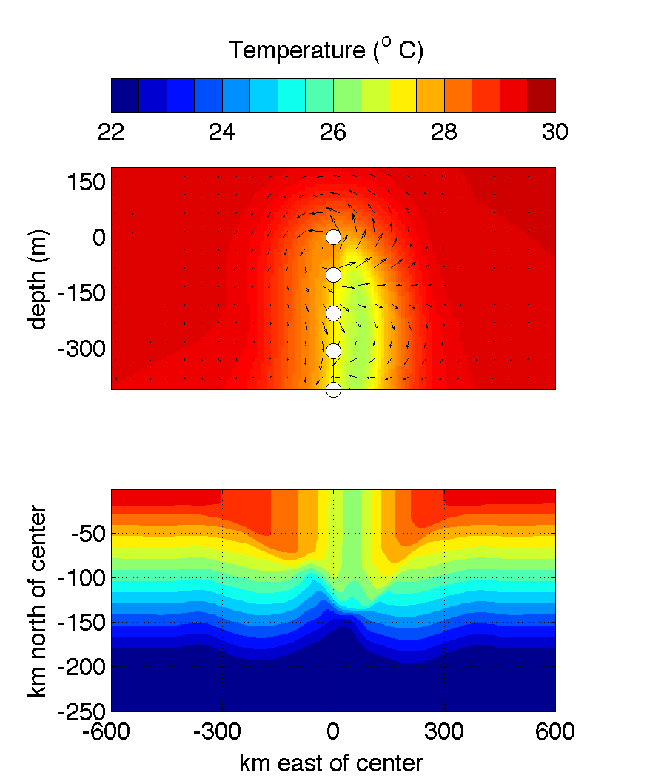
1-D processes
Hurricanes cool the ocean surface through:
vertical (turbulent) mixing
(2) surface heat flux
Vertical mixing drives ~85%
of sea surface temperature
cooling
Strong Winds
depth (m)
Vertical Mixing

Slide 18
Vertical Mixing Parameterization
Turbulent flux terms are assumed proportional to the vertical shear of the mean variables, e.g.
The turbulent mixing coefficient K is parameterized using either
Mellor–Yamada level 2.5 turbulence closure model (M-Y scheme) or
K-Profile Parameterization (KPP scheme) :
Momentum
Temperature
h - mixing layer depth
W- turbulent velocity scale
G(z)- non-dimensional shape-function

Slide 19
3-D processes
Strong Winds
Hurricane induced upwelling and horizontal advection can enhance and/or modify surface cooling.
Horizontal Advection
depth (m)
Upwelling
km

Slide 20
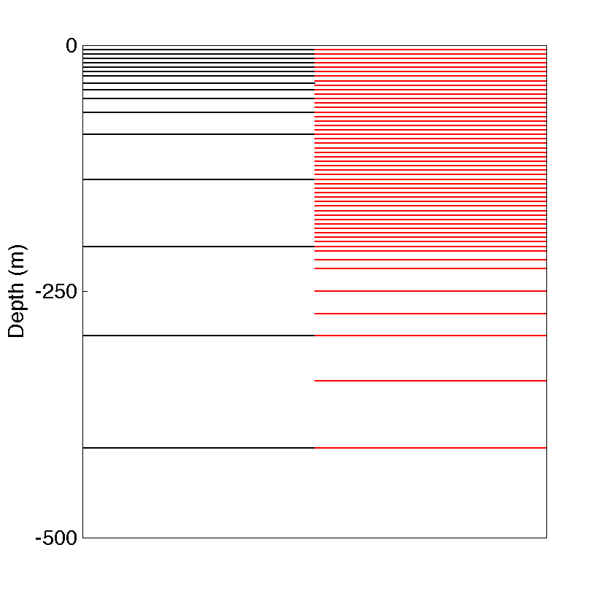
Impact of increased vertical resolution
Higher resolution (60 level) sensitivity tests
23 levels (default)
60 levels
- 60 level MPIPOM maintains ~5 m resolution to mixing depth of ~200 m (for 2500 m ocean depth)
- 23 level MPIPOM has vertical level resolution of ~50 m at 200 m depth (for 2500 m ocean depth)
-2500

Slide 21
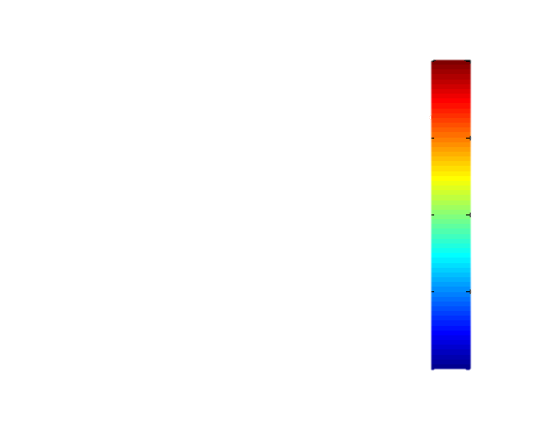
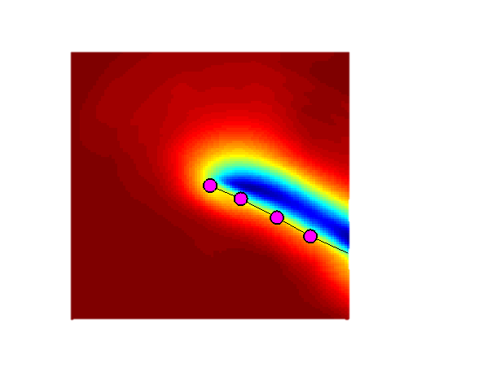
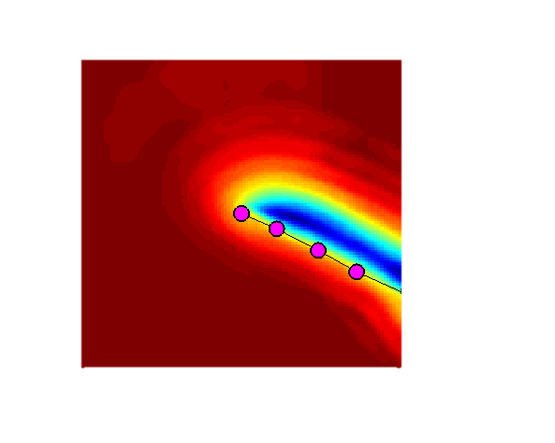
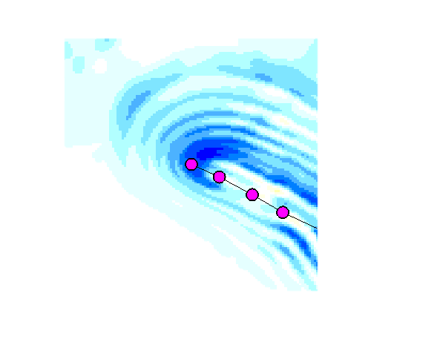
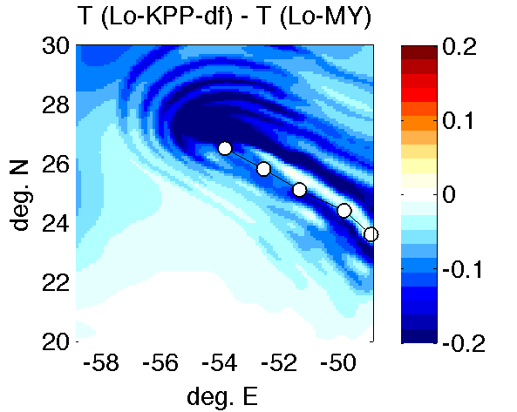
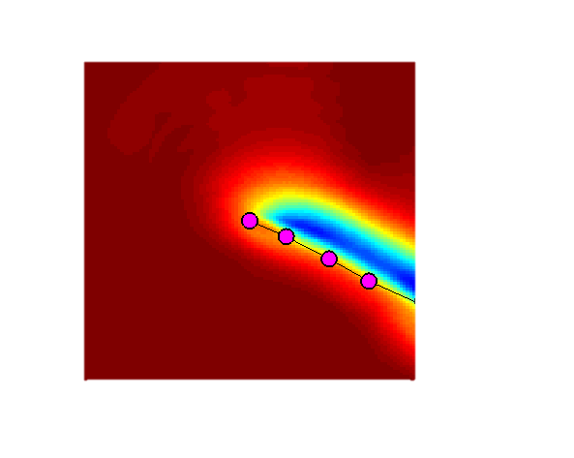
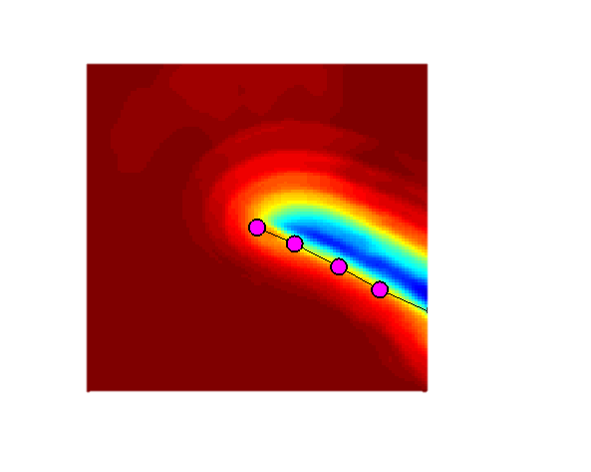
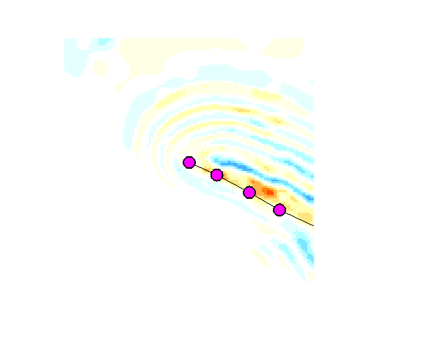
Hurricane Edouard 09/15 12Z, 2014
KPP: more cooling for 60 levels by up to 0.2°
M-Y: Impact of increased vertical resolution is small
a. KPP (60 levels)
b. KPP (23 levels)
plot a – plot b
31N
.25°
0° C
27N
-.5°
23N
c. MY (60 levels)
d. M-Y (23 levels)
-1°
plot c – plot d
0°
31N
27N
-1.5°
-2°
-.25°
23N
-60E
-56E
-52E
-60E
-56E
-52E
-60E
-56E
-52E

Slide 22
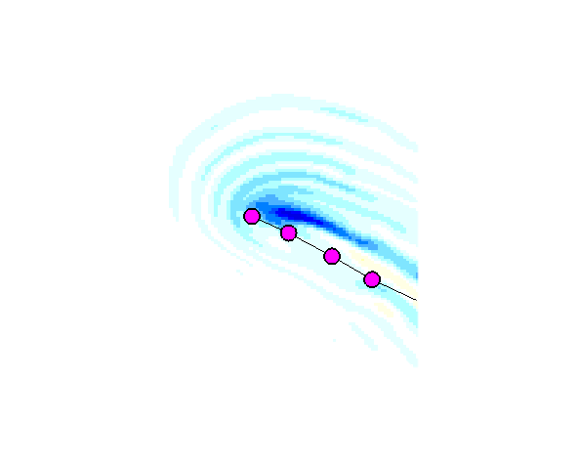
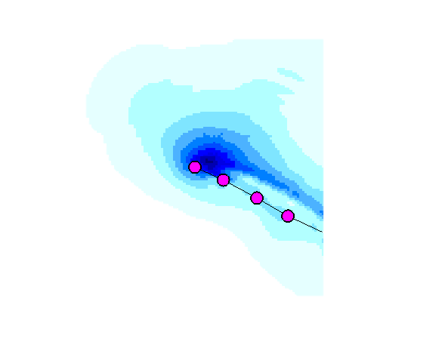
Hurricane Edouard 09/15 12Z, 2014
60 level noticeably smoother than 23 level
KPP produces up to 0.5° C more cooling than M-Y
a. KPP-df (23 levels)
b. M-Y (23 levels)
plot a – plot b
31N
.5°
0° C
27N
-.5°
23N
c. KPP-df (60 levels)
d. M-Y (60 levels)
-1°
plot c – plot d
0°
31N
27N
-1.5°
-2°
-.5°
23N
-60E
-56E
-52E
-60E
-56E
-52E
-60E
-56E
-52E

Slide 23
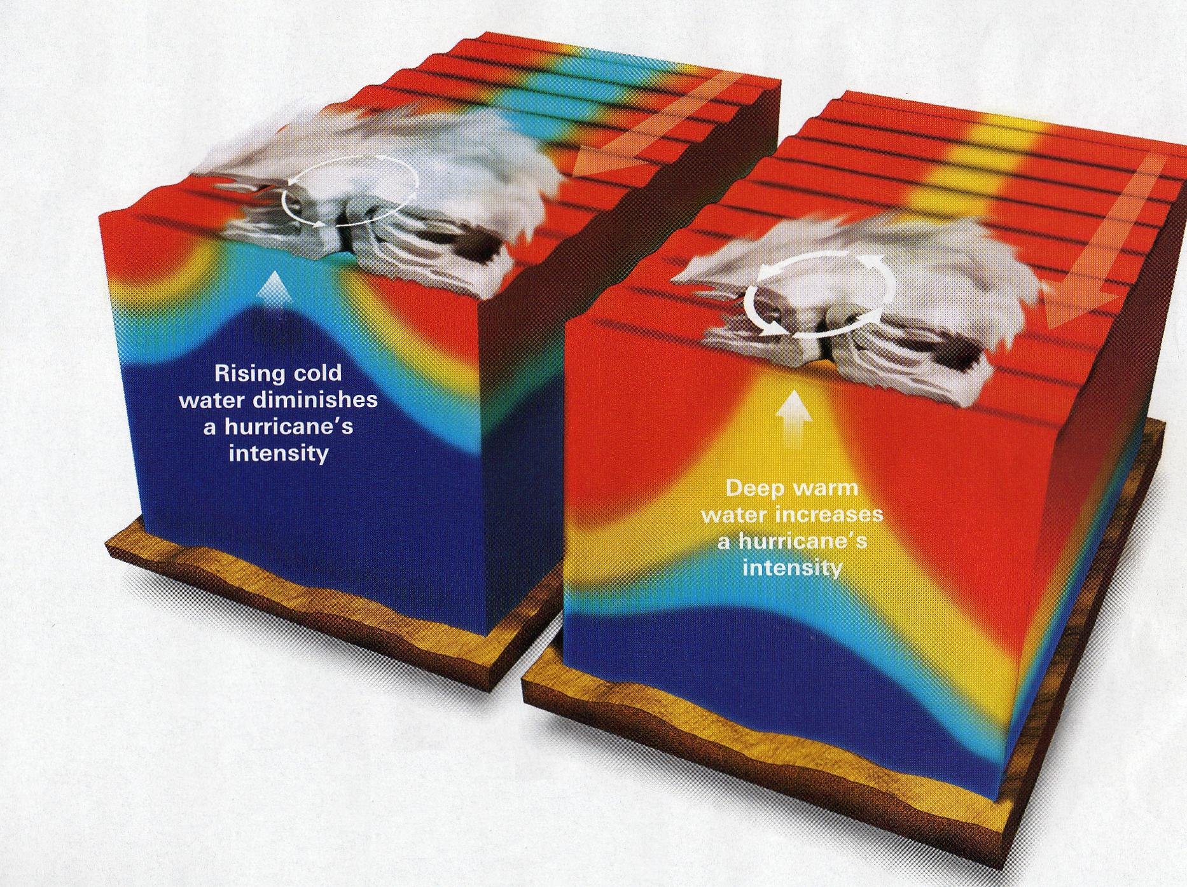
Effect of Ocean Stratification on SST cooling
Typical of
Gulf of Mexico in
Summer & Fall
Typical of
Caribbean in
Summer & Fall

Slide 24
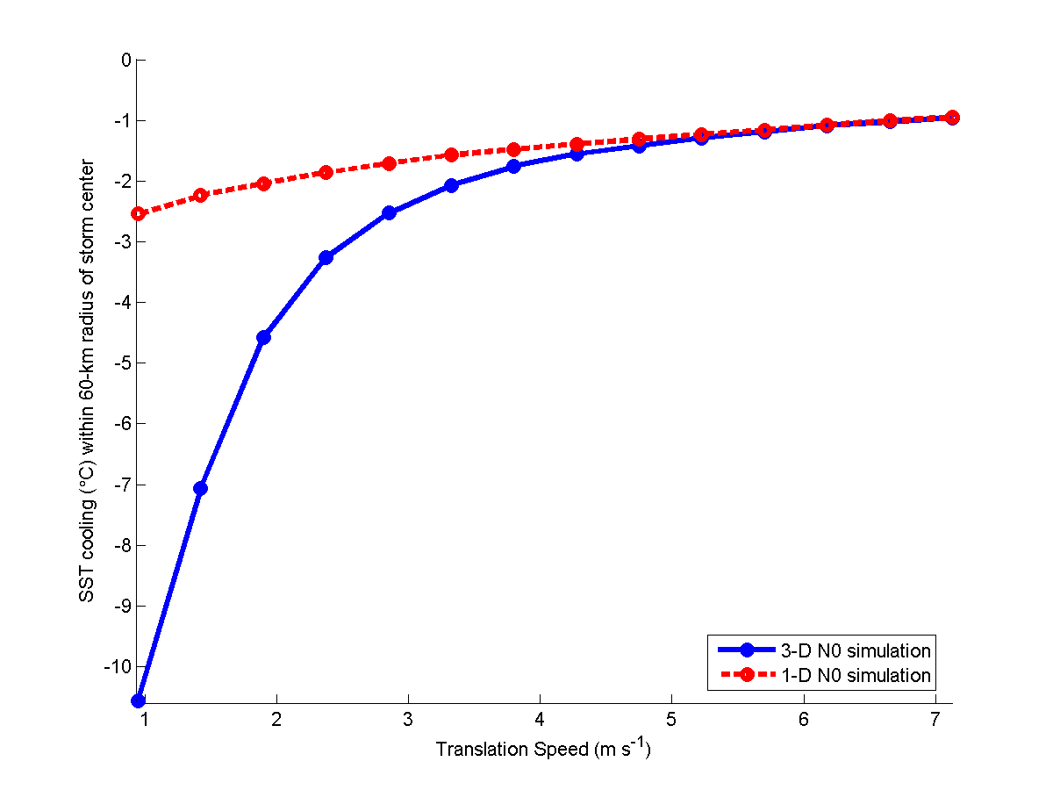
Effect of TC translation speed on SST cooling
2.4 m s⁻¹
4.8 m s⁻¹
Hurricanes have historically propagated
in the Gulf of Mexico:
< 5 m s⁻¹ 73% and < 2 m s⁻¹ 16% of the time
And in the western tropical North Atlantic:
< 5 m s⁻¹ 62% and < 2 m s⁻¹ 12% of the time
So 3-D effects (e.g. upwelling) are important
Yablonsky and Ginis (2009, Mon. Wea. Rev.)

Slide 25
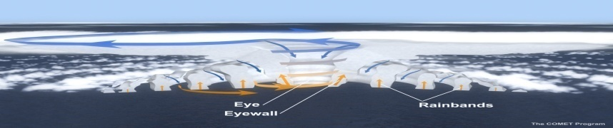
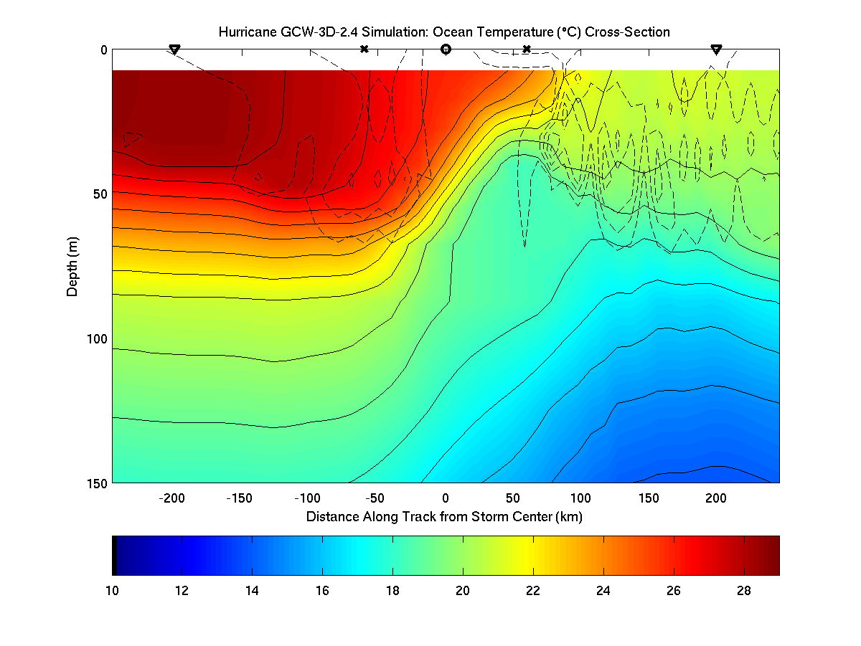
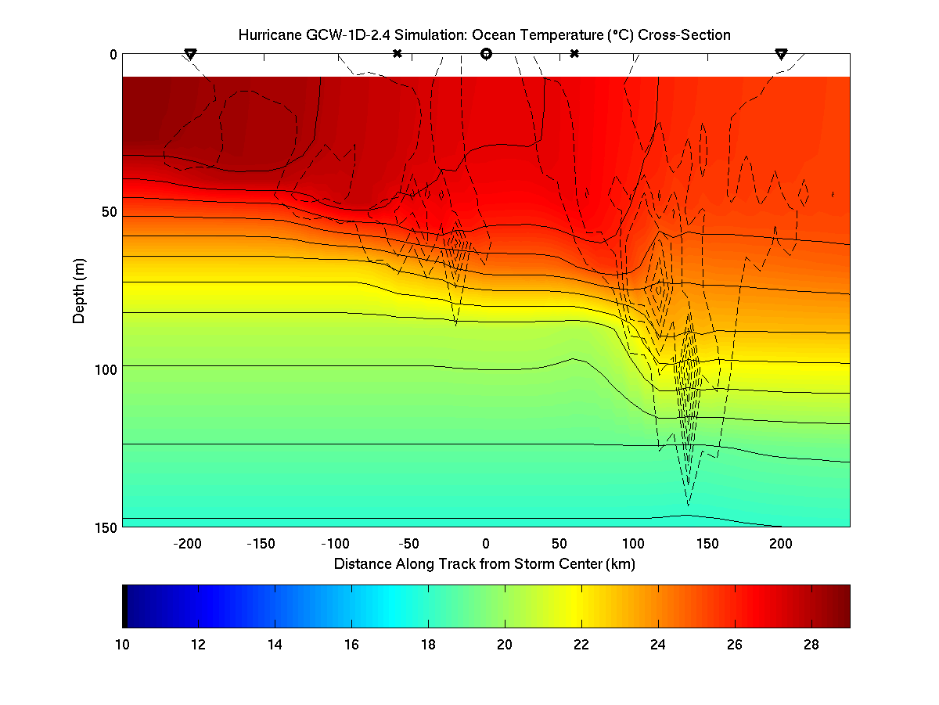
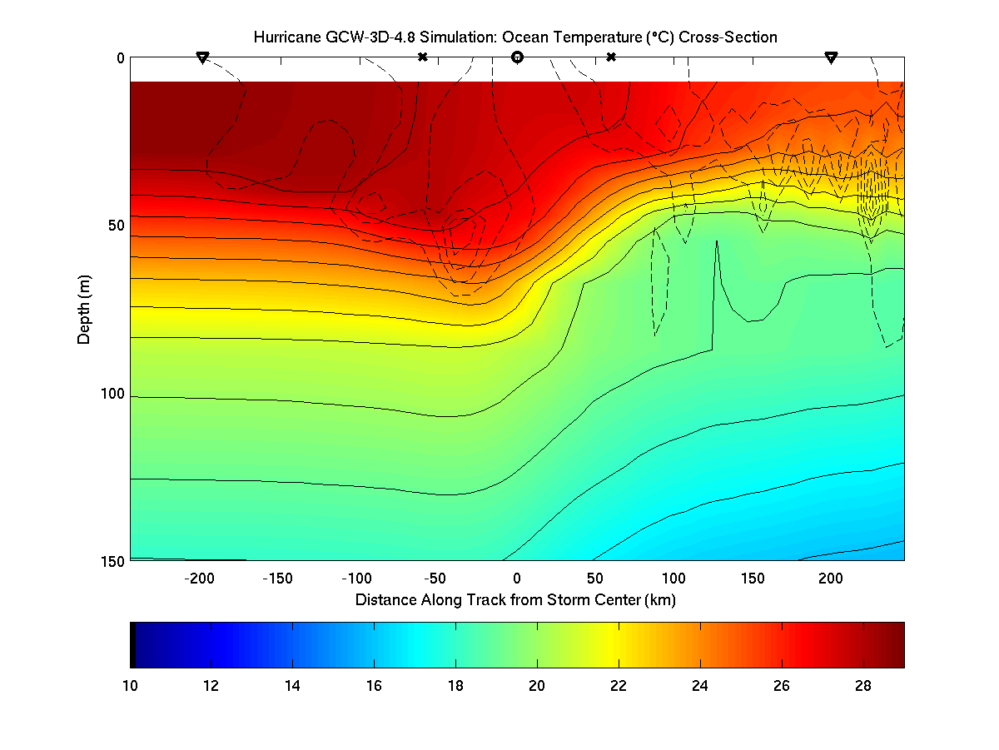
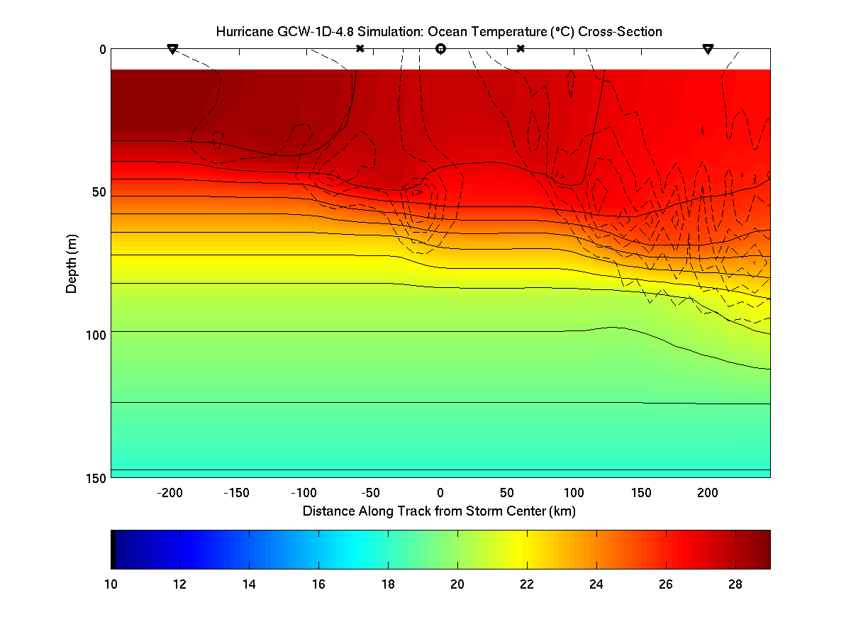
3-D
1-D
2.4 m s⁻¹
3-D
1-D
4.8 m s⁻¹

Slide 26
POM Initialization

Slide 27
Flexible Initialization Options
Feature-based modifications to GDEM monthly temperature (T) and salinity (S) climatology with assimilated daily GFS SST (FB)
Navy Ocean Data Assimilation daily T and S fields (NCODA)
HYbrid Coordinate Ocean Model global daily product (HYCOM)
* All of these ocean products are available in the public domain
for real time tropical cyclone forecasting

Slide 28
Feature-based (FB) initialization
Prior to coupled model integration, POM is initialized with a realistic, 3-D temperature (T) and salinity (S) field
This T & S field must then be used to generate realistic ocean currents via geostrophic adjustment
The “spun-up” ocean must then incorporate the preexisting hurricane-generated cold wake by applying TC’s wind stress using the NHC hurricane message file

Slide 29
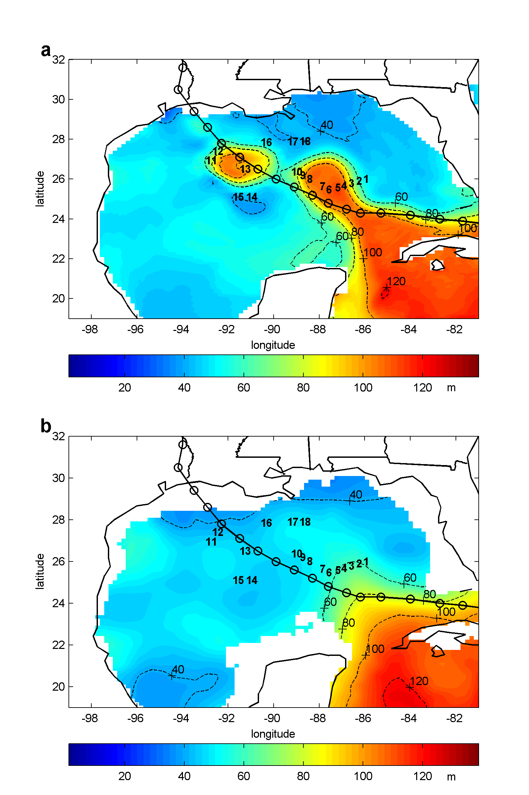
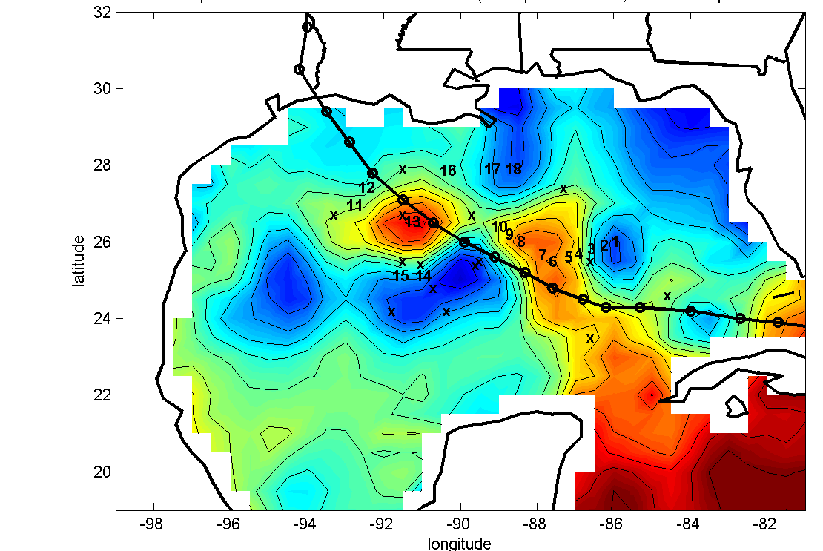
Feature-based Initialization
Start with
GDEM T/S
Look at
altimetry/obs
GDEM
Data-assimilated
Or… define using real
obs: e.g. AXBT 6 for
LC and AXBT 13 (14)
for WCR (CCR)
Define LC &
ring positions
x
x
Use Caribbean
water along
LC axis & in
WCR center
x
x
x
x
x
x
x
x
x
x
x
x
x
Altimetry
Make CCR
center colder
than environ.
Finally, assimilate SST
and integrate ocean
model for 48 hrs for
geostrophic adjustment
Blend features
w/ env. &
sharpen fronts

Slide 30
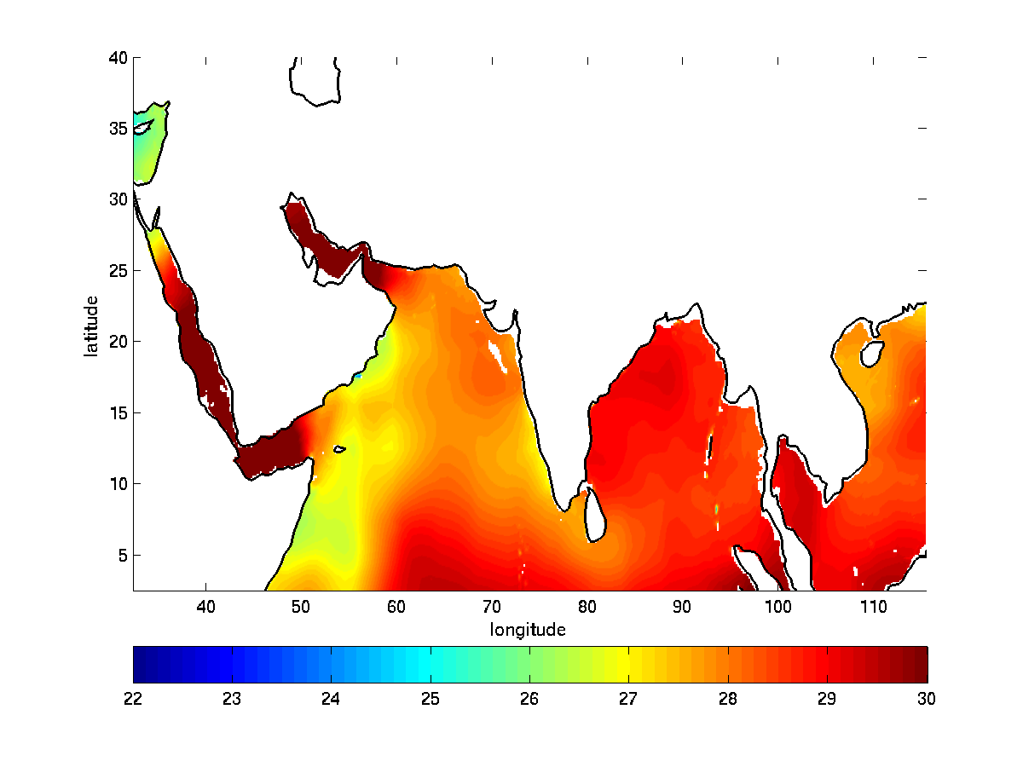
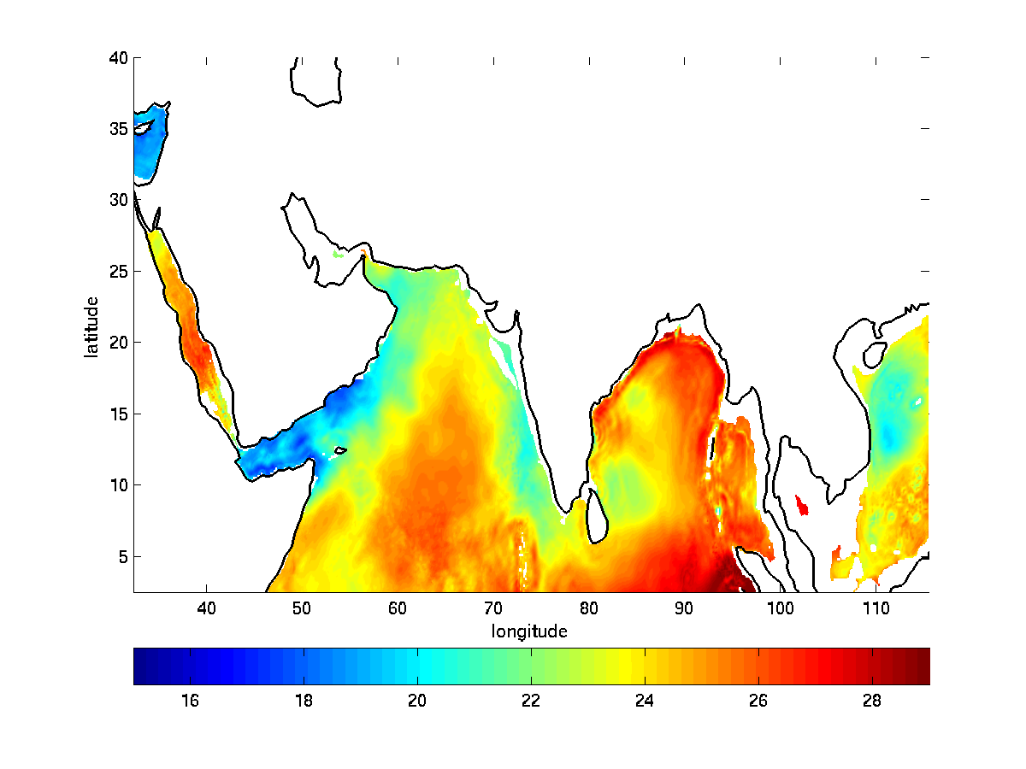
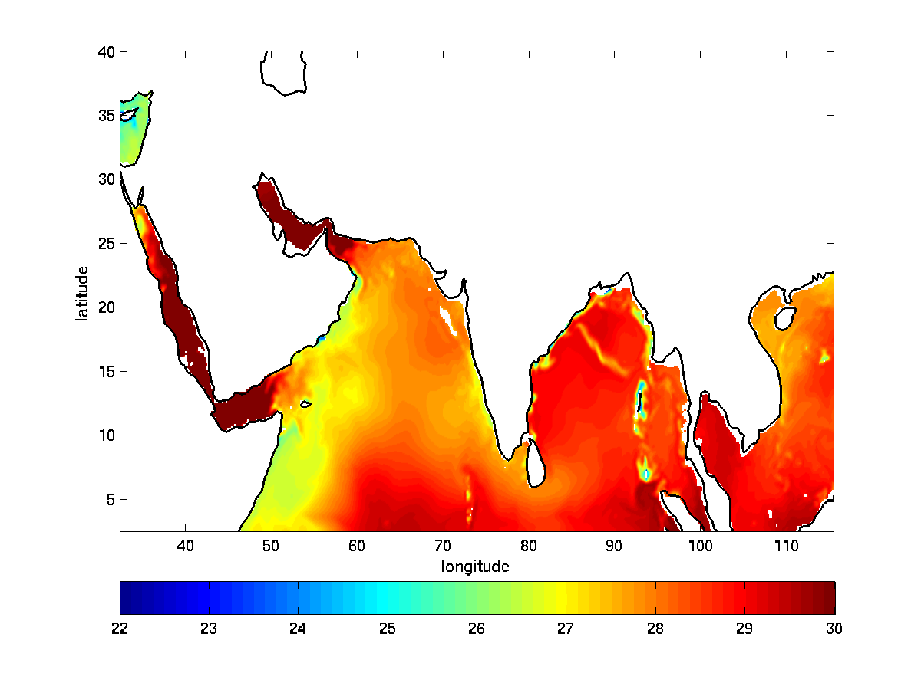
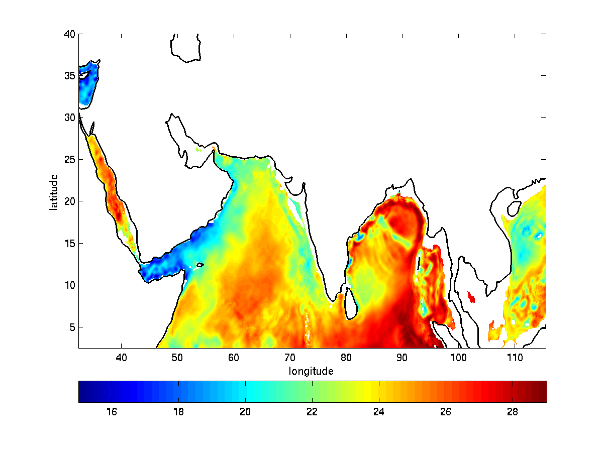
MPIPOM North Indian Domain: Ocean Response to Cyclone Phailin with FB initialization: 2013100600-1400
06/00Z
SST
06/00Z
77.5-m T
14/00Z
77.5-m T
14/00Z
SST

Slide 31
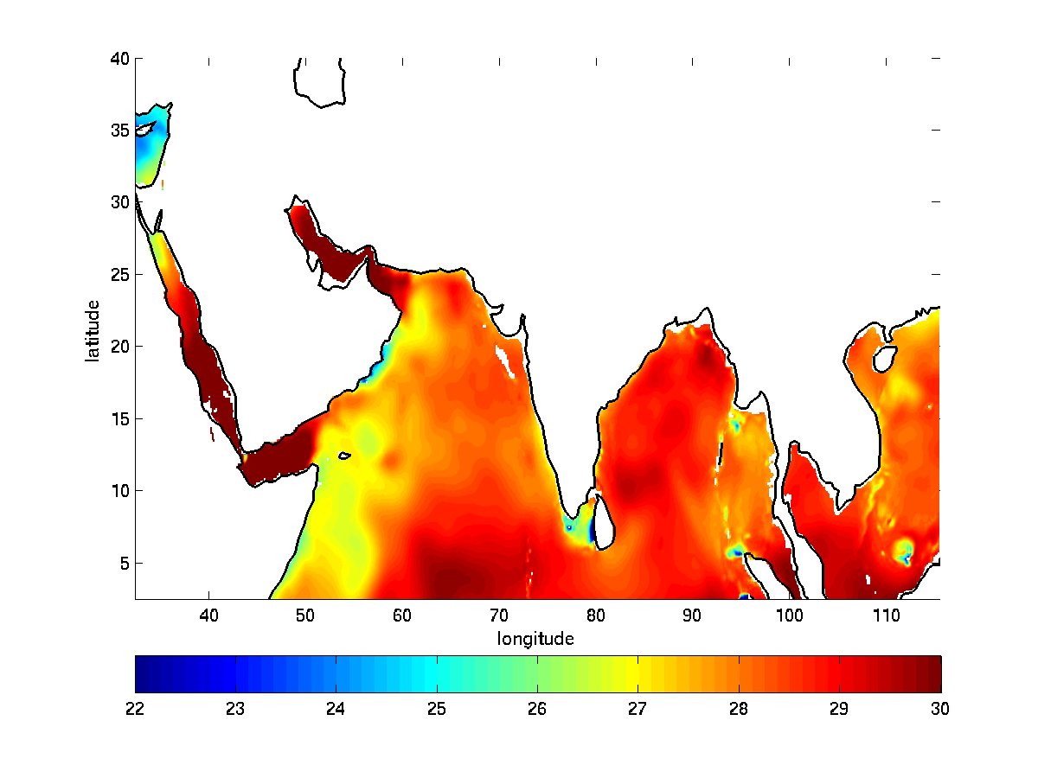
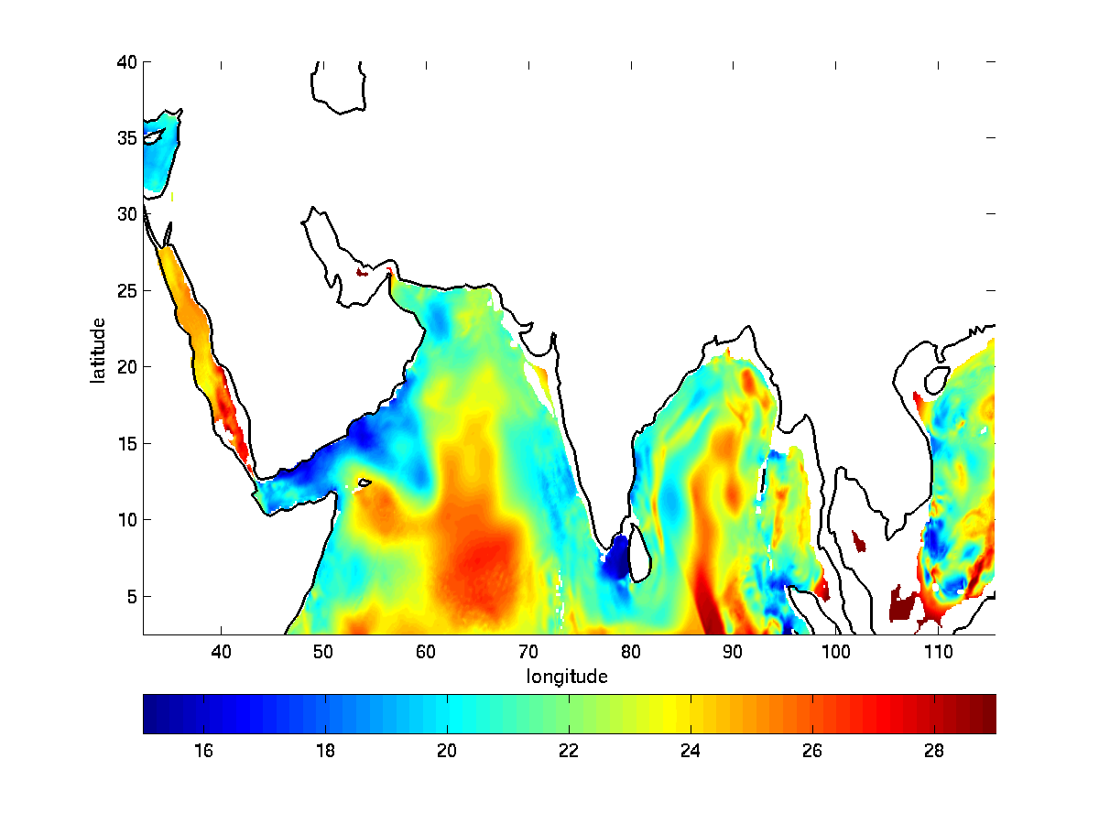
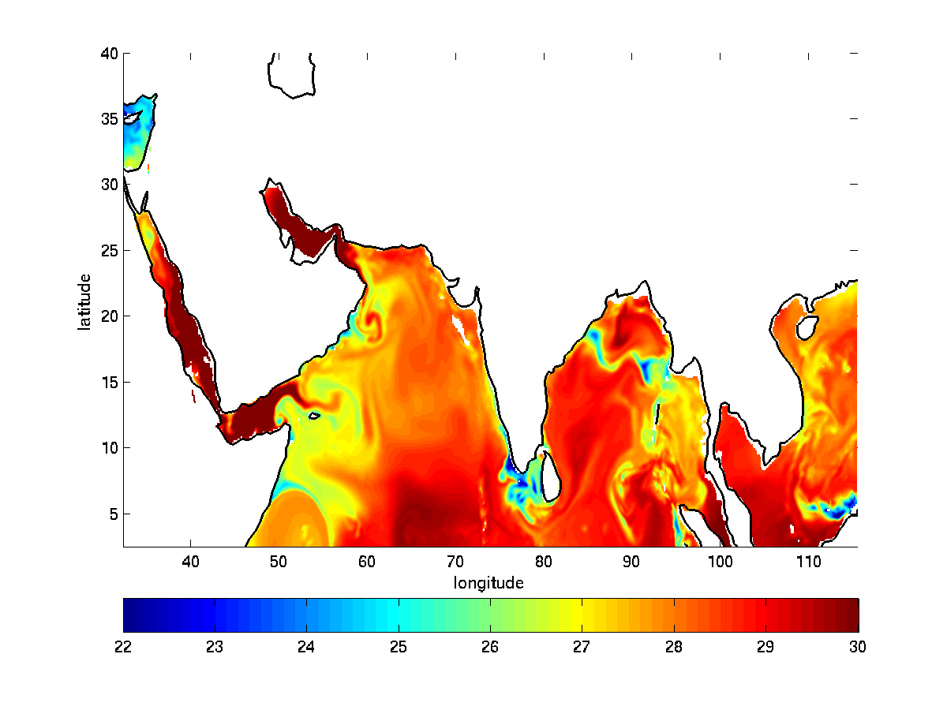
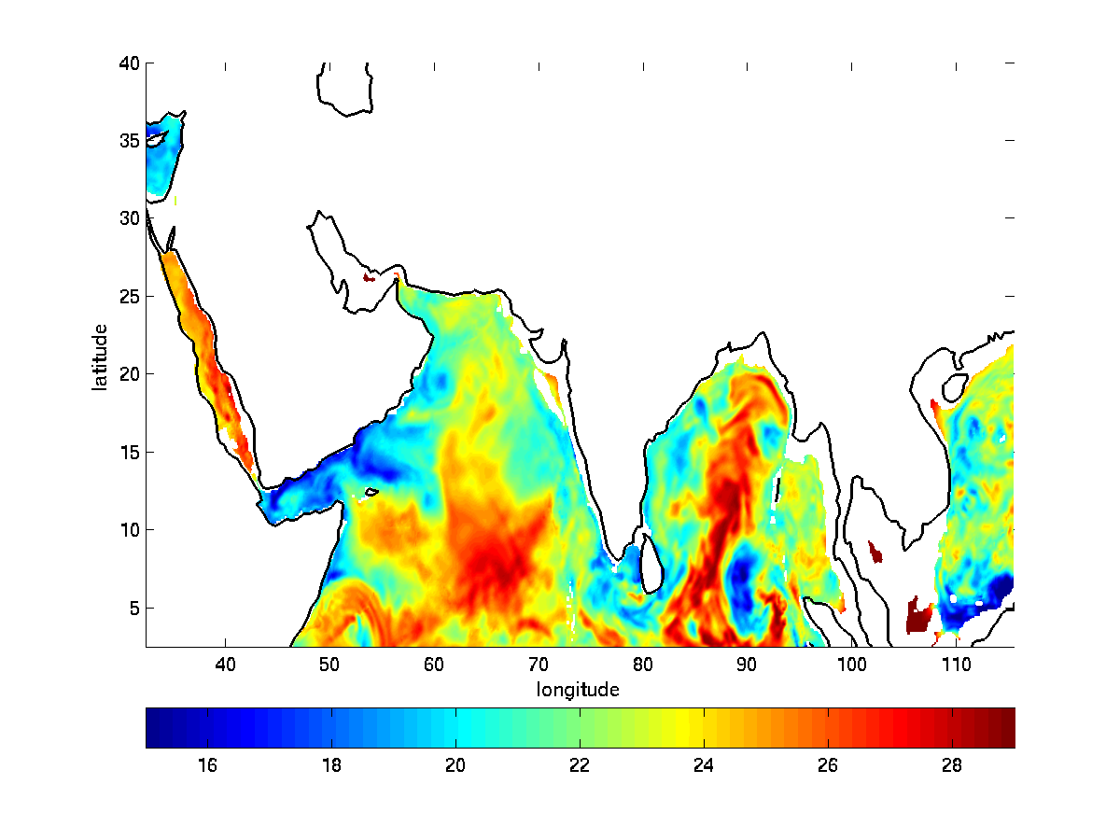
MPIPOM-TC North Indian Domain: Ocean Response to Cyclone Phailin with NCODA initialization: 2013100600-1400
06/00Z
SST
06/00Z
77.5-m T
14/00Z
77.5-m T
14/00Z
SST

Slide 32
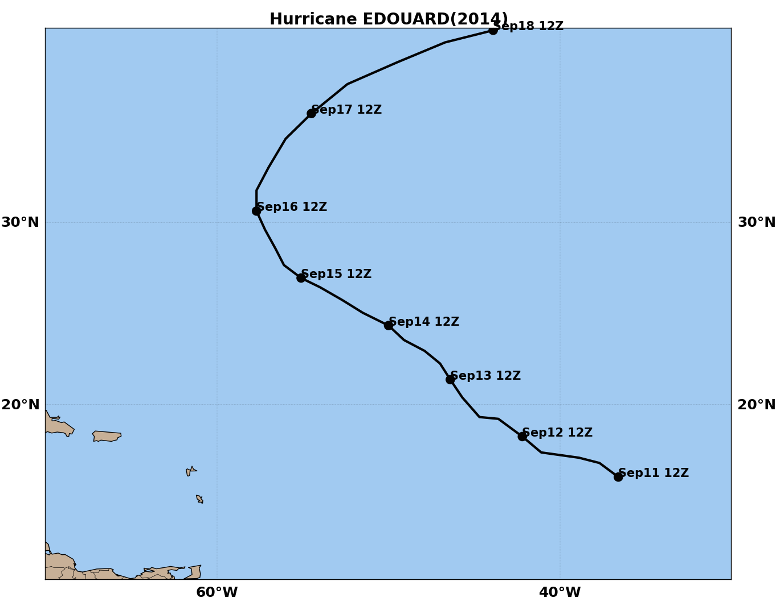
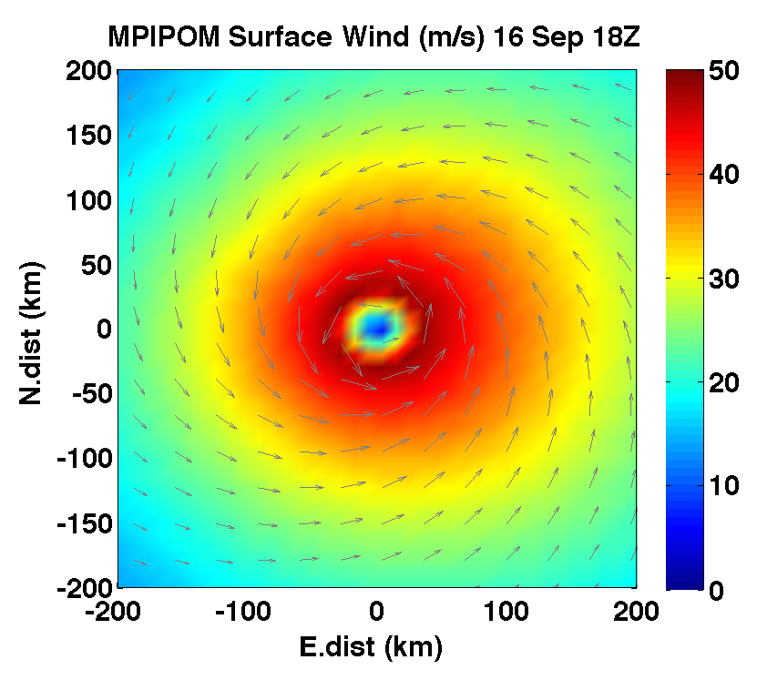
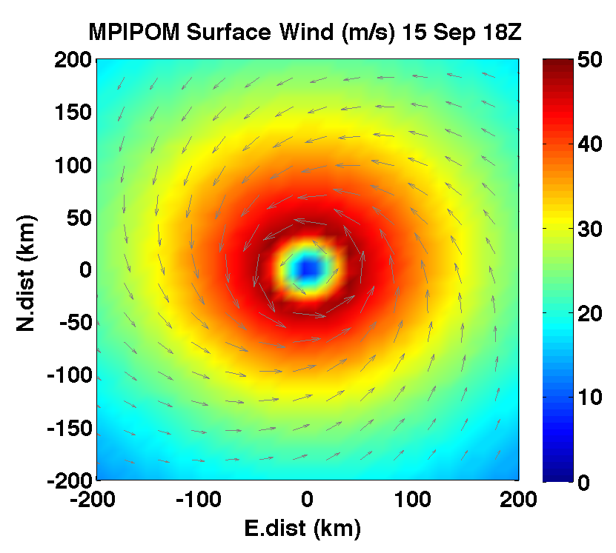
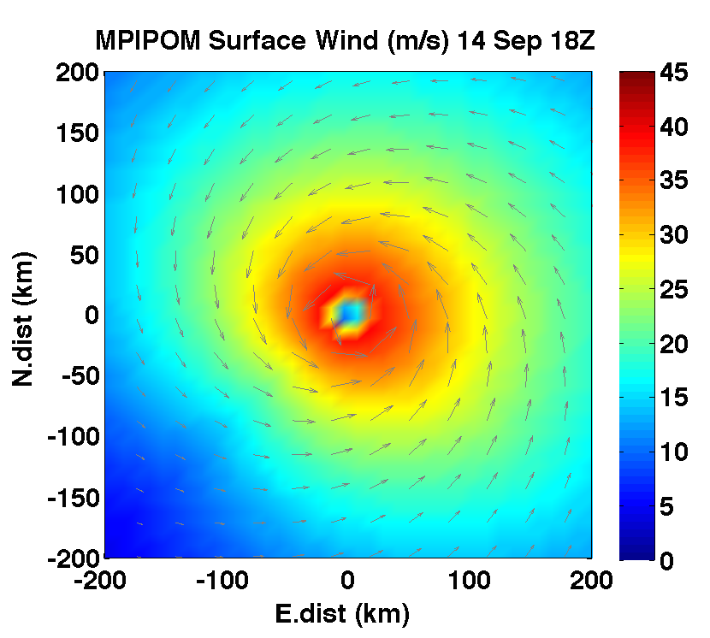
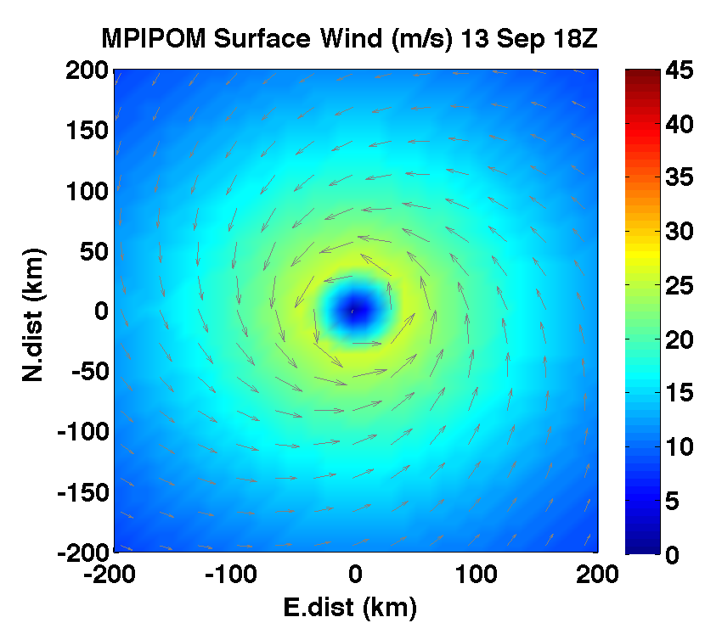
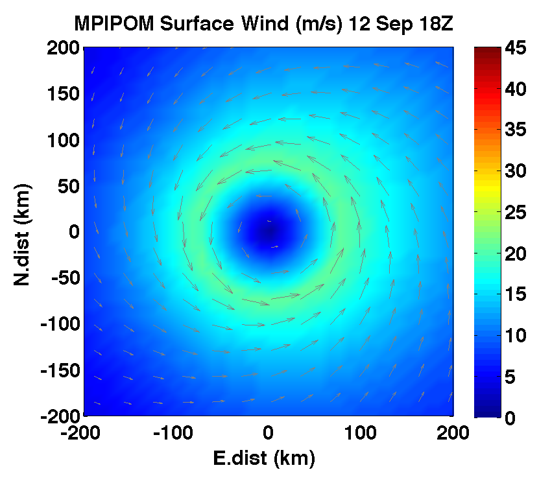
Evaluation of Ocean Initialization Options: Hurricane Edouard (2014)
Wind fields are specified
based on the NHC
real-time message files (TC vitals)

Slide 33
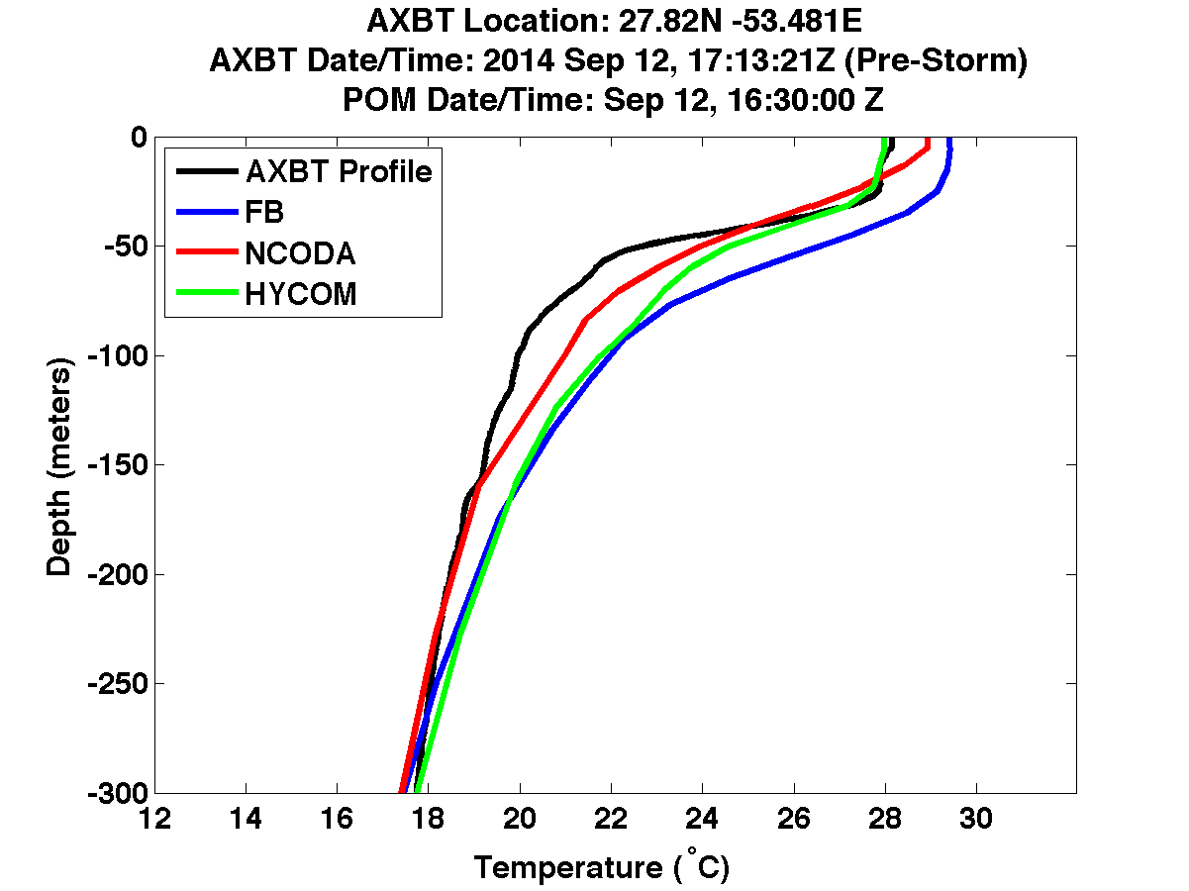
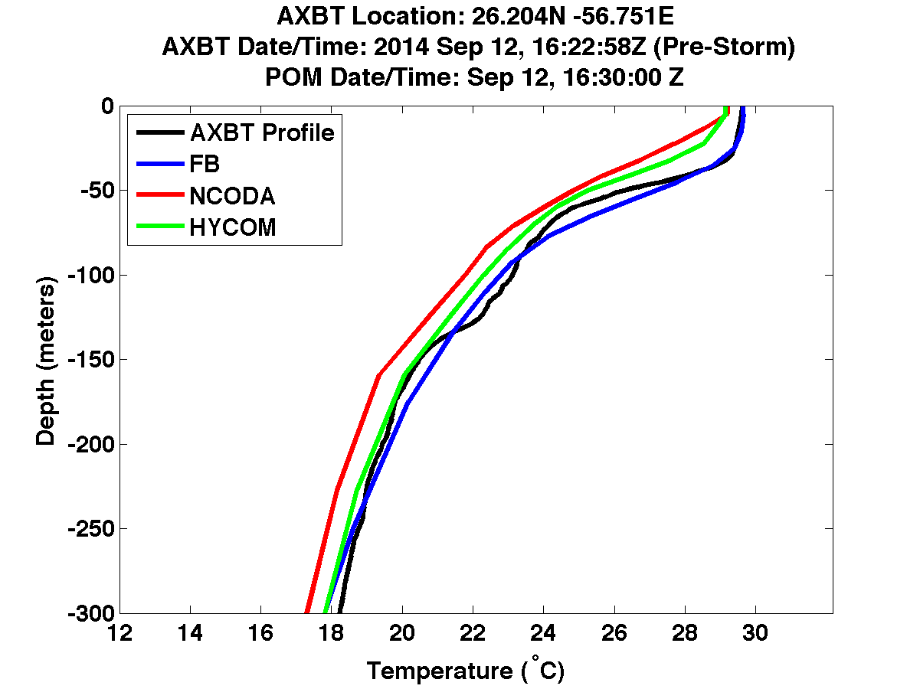
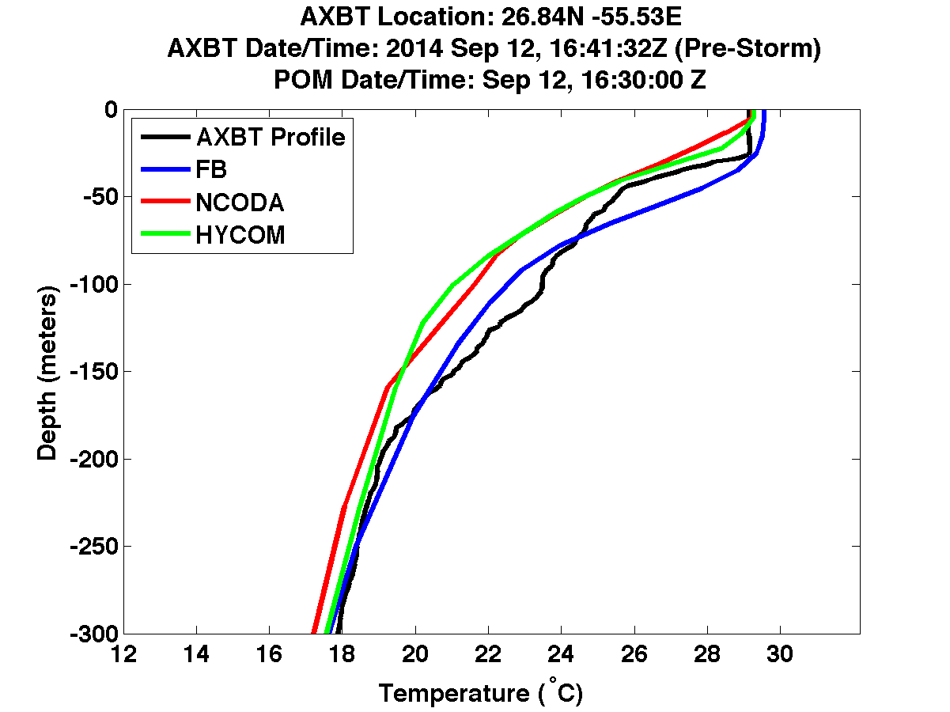
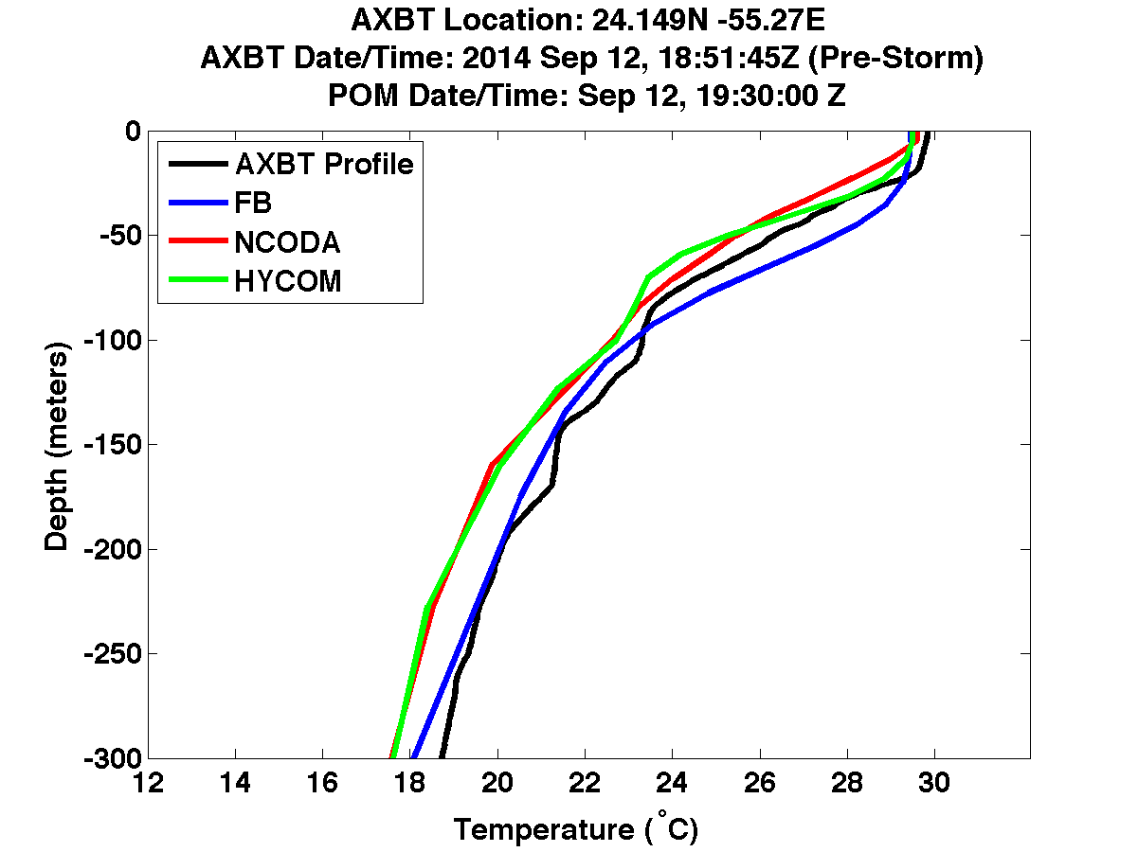
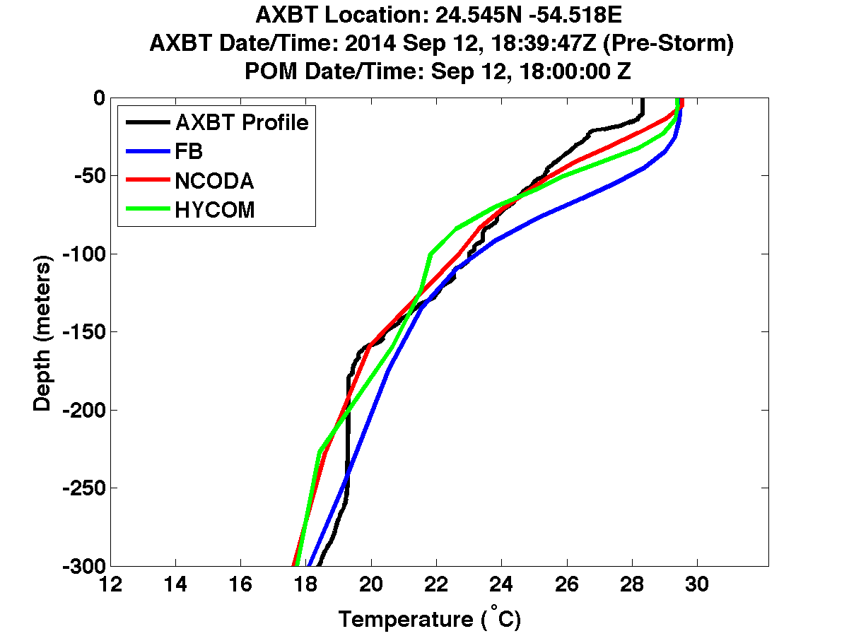
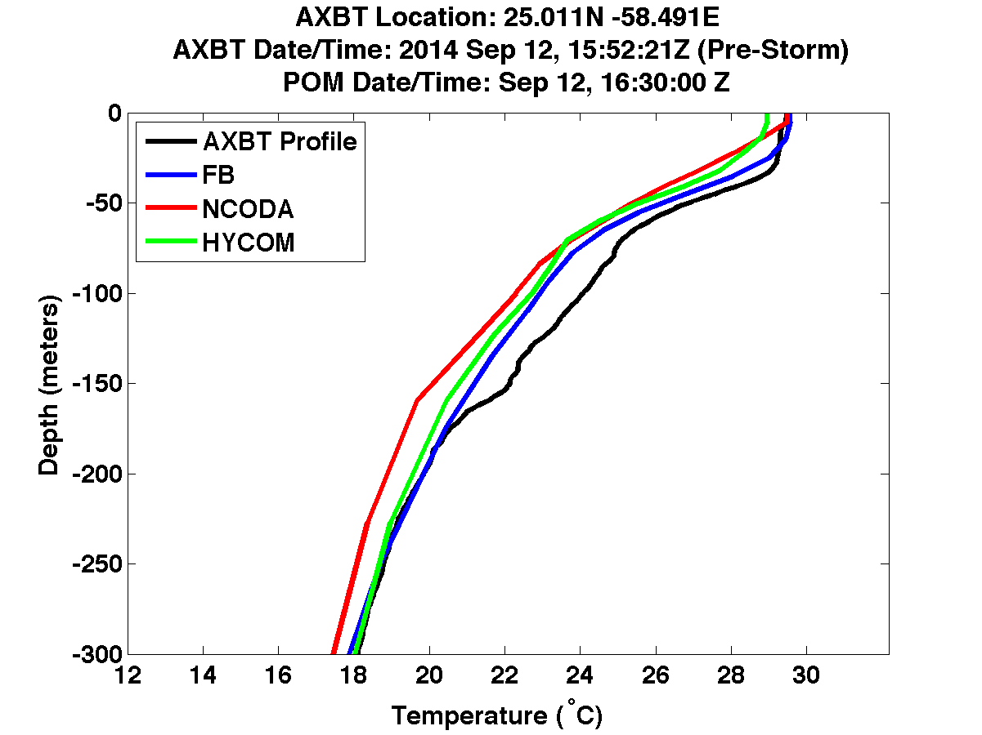
Evaluation of Ocean Initialization Options: Comparison with AXBTs
September 12, 2014 (pre-storm)

Slide 34
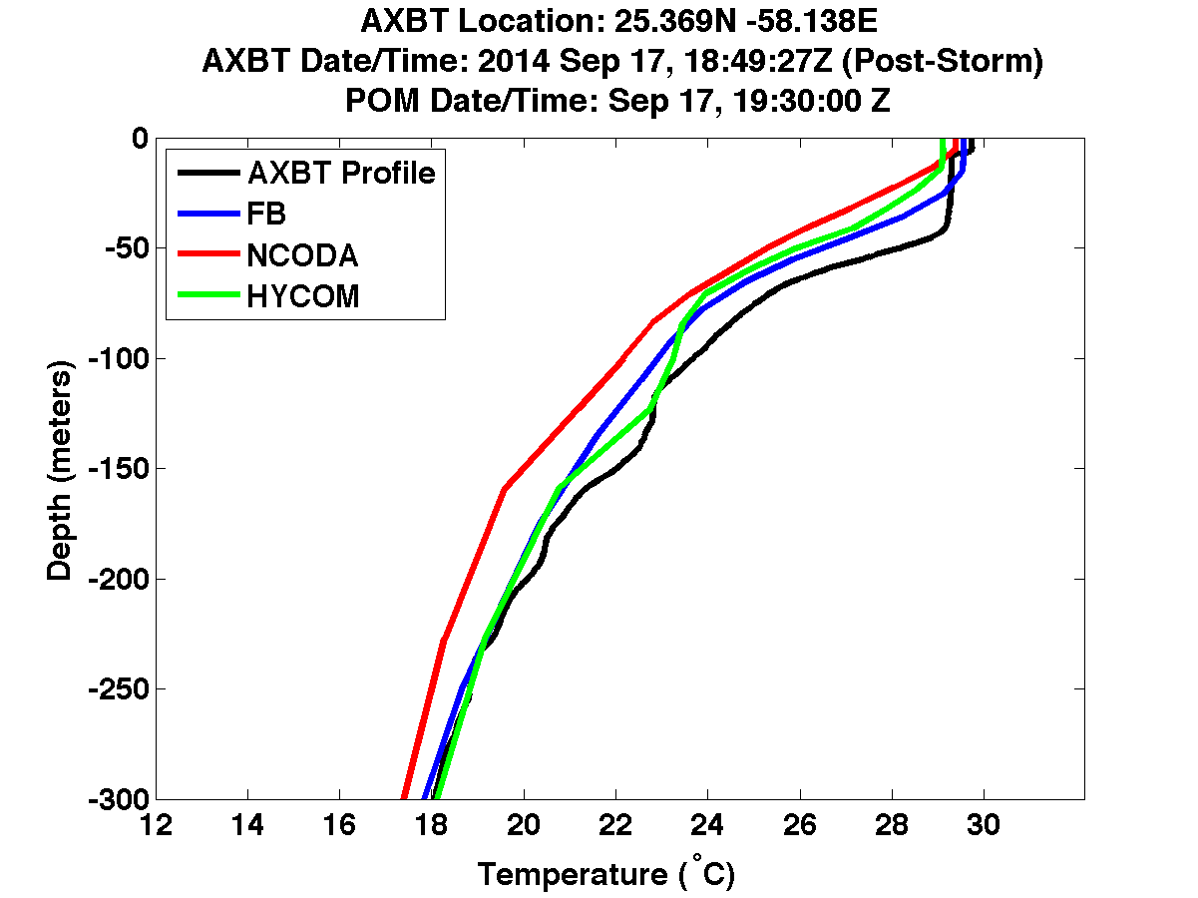
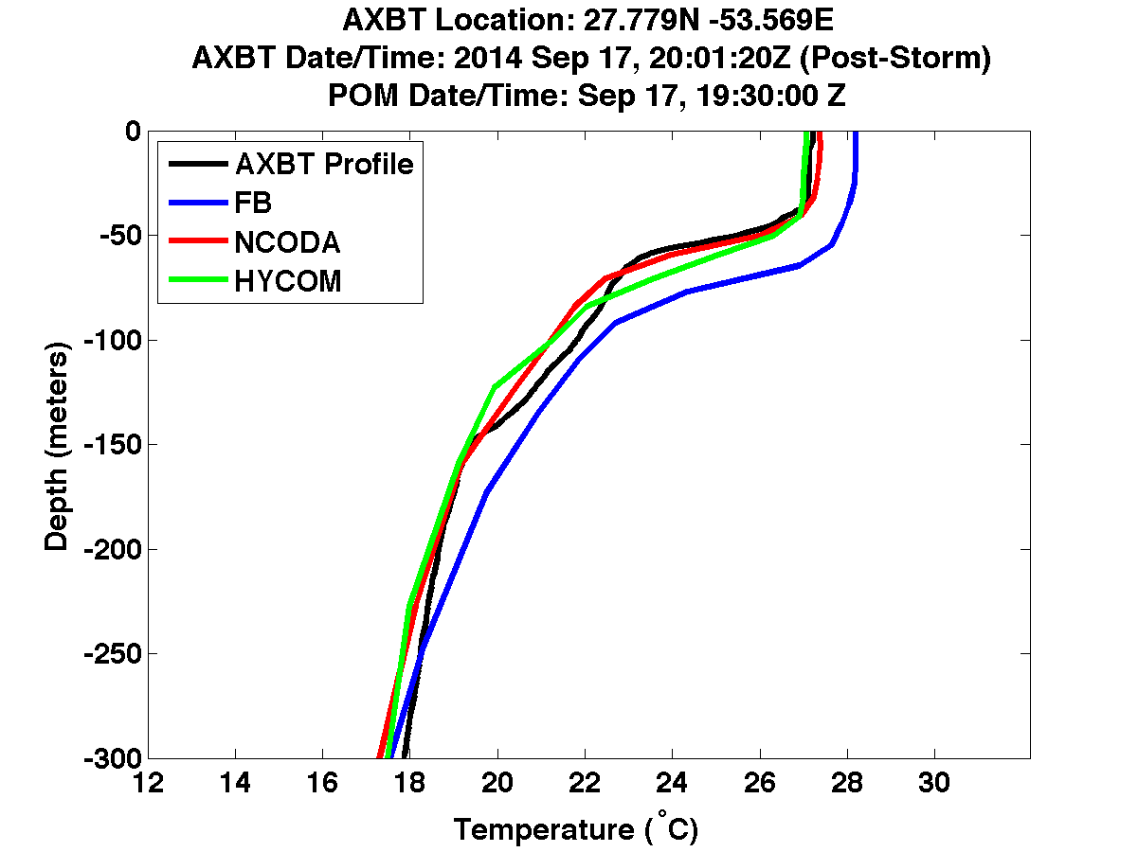




Evaluation of Ocean Initialization Options: Comparison with AXBTs
September 17, 2014 (post-storm)

Slide 35
Atmosphere-Ocean Coupling
Atmospheric Model
Wind speed (U_{a})
Temperature (T_{a})
Humidity (q_{a})
Surface current (U_{s})
SST (T_{s})
Momentum flux (τ)
Sensible heat flux (Q_{H})
Latent heat flux (Q_{E})
Momentum flux (τ)
Air-Sea Interface
Ocean Model

Slide 36


Motivation: air-sea fluxes and turbulent mixing above/below sea surface are significantly modified by surface waves in high wind conditions.
Developing Air-Sea Interface Module (ASIM)
with explicit wave coupling
Image courtesy of Fabrice Veron

Slide 37
Wave-dependent physics in HWRF
Atmosphere
α
γ
SST
Q_{air}
Z_{ref}
H_{s}
U_{c}
R_{air}
U_{ref}
c_{p}
τ_{air}
Rib
KE_{D}
Ocean
τ_{diff}
τ_{cor}
λ
U_{s}
Waves
U_{c}
U_{λ}
Atmospheric model: air-sea fluxes depend on sea state
Wave model: forced by sea state dependent wind forcing
Ocean model: forced by sea state dependent wind stress modified by growing or decaying wave fields and Coriolis-Stokes effect. Turbulent mixing is modified by the Stokes drift (Langmiur turbulence).

Slide 38
τ_{air} – atm. stress
F_{Q} – latent heat flux
F_{S} – sensible heat flux
F_{R} – radiation heat flux
θ – potential temperature
R_{ref}– atm. spec. humidity
Ri_{b} – bulk Richardson num.
U_{ref} – atm. wind
τ_{c} – stress on currents
SST – sea surf. temp.
Atmospheric Model
U_{c} – surface current
U_{λ} – current at depth
λ – mean wavelength
γ –wind/stress misalignment
α – Charnock coeff.
τ_{Cor} - Coriolis-Stokes stress
τ_{dif} – wave mom. budget
Ψ – wave spectrum
U_{s} – Stokes drift
U_{10N} – neutral 10m wind
τ_{air}, F_{Q}, F_{S}
R_{ref}, U_{ref}, θ_{ref}
U_{ref},F_{R}
ASIM
Atm.
fluxes
γ, α,
U_{c}, SST
Ri_{b}, τ_{air}, F_{S}, F_{Q}
U_{c},
U_{λ},
SST
Ocean
Model
Coupler
λ
Wave
Model
U_{s}, λ,
F_{R},
F_{Q} ,
F_{S}
U_{λ}
τ_{diff}, τ_{Cor},τ_{air}
τ_{diff}, τ_{Cor},
α, γ, U_{s}
U_{ref},
Ri_{b}, U_{c}
Ψ
Ocean
fluxes
Wave
fluxes
τ_{c}
U_{10N}

Slide 39




Examples of sea state dependent C_{d} in WW3-MPIPOM coupled model (wind is prescribed)
RMS= 70 km, U_{10max}= 65 m/s
U_{T}=10 m/s
U_{T}=5 m/s

Slide 40
Wave dependent surface boundary conditions in the ocean model
Wind stress
Wave momentum budget
Coriolis-Stokes
: Stokes drift :Radiation stress

Slide 41




Hurricane Edouard, Coupled WW3-MPIPOM: Effect of wave dependent surface boundary conditions

Slide 42
Langmuir turbulence modifications in KPP
1. Enhance K based on the Langmuir number
2. Use the Lagrangian current in place of the Eulerian current in KPP
Eulerian current
Stokes drift
Lagrangian current

Slide 43
Langmuir turbulence modifications in KPP
The enhancement factor needed in the KPP mixing coefficient is then found from the LES results
LES
KPP
Enhanced KPP
0 0.2
0 0.2
mixing coefficient
Left of hurricane
mixing coefficient
Right of hurricane

Slide 44


Langmuir impact on SST cooling (Hurricane Edouard): KPP-LT vs KPP and M-Y
KPP-LT
MY
KPP
September 15
September 16

Slide 45
References
Mellor, G. L., 2004: User’s guide for a three-dimensional, primitive equation, numerical ocean model (June 2004 version). Prog. in Atmos. and Ocean. Sci., Princeton University, 56 pp.
Reichl, B. G., T. Hara, and I. Ginis, 2014: Sea state dependence of the wind stress over the ocean under hurricane winds. J. Geophys. Res. Oceans, 119, 30-51.
Rabe, T. J., T. Kukulka, I. Ginis, T. Hara, B. G. Reichl, E. A. D’Asaro, R. R. Harcourt, and P. Sullivan, 2015: Langmuir turbulence under hurricane Gustav (2008). Journal of Physical Oceanography, 45, 657–677.
Reichl, B. G, D. Wang, T. Hara, I. Ginis,, T. Kukulka, 2016: Langmuir turbulence parameterization in tropical cyclone conditions, Journal of Physical Oceanography, in press.
Yablonsky, R. M., and I. Ginis, 2008: Improving the ocean initialization of coupled hurricane-ocean models using feature-based data assimilation. Mon. Wea. Rev., 136, 2592-2607.
Yablonsky, R. M., and I. Ginis, 2009: Limitation of one-dimensional ocean models for coupled hurricane-ocean model forecasts. Mon. Wea. Rev., 137, 4410-4419.
Yablonsky, R. M., I. Ginis, B. Thomas, V. Tallapragada, D. Sheinin, and L. Bernardet, 2015: Description and analysis of the ocean component of NOAA's operational Hurricane Weather Research and Forecasting (HWRF) Model. J. Atmos. Oceanic Technol., 32, 144–163.
Yablonsky, R. M., I. Ginis, B. Thomas, 2015: Ocean modeling with flexible initialization for improved coupled tropical cyclone-ocean prediction, Environmental Modelling & Software, 67, 26-30.

